Slide 1
Curves, Fractals and Shading

Slide 2
Introduction
Graphics scenes can contain many different kinds of objects: trees,flowers,clouds,rocks,water,bricks,wood,rubber,paper, marbel,steel,glass, plastic, and cloth.
Smooth curves and surfaces are generated in many CG applications.
Many real world objects are inherently smooth.
The need to represent curves and surfaces in two cases:
In modeling of existing objects: Ex- car, a face, a mountain.
When there is no pre-existing object to model.

Slide 3
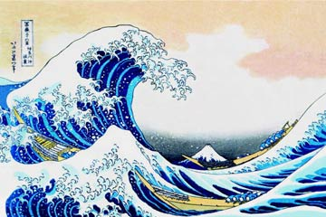
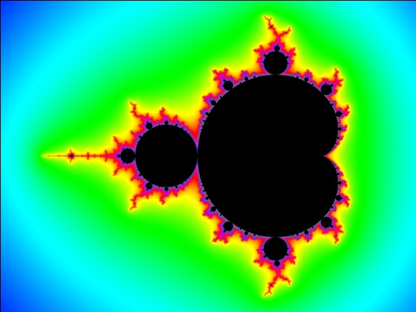
Polygon and Quadric surfaces provide precise description to create simple objects.
Spline surfaces helps to build aircraft wings, gears, and other curved objects.
Fractal a curve or geometrical figure, each part of which has the same statistical character as the whole. It helps to represent clouds, natural objects.

Slide 4
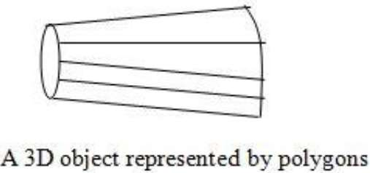
Polygon Surfaces
Objects are represented as a collection of surfaces.
The most commonly used boundary representation for a three dimensional graphics is a set of surface polygons that enclose object interior.
Many graphics systems store all objects descriptions as sets of surface polygons. This simplifies and speeds up the surface rendering and display of objects, since all the surfaces are described with linear equations.

Slide 5
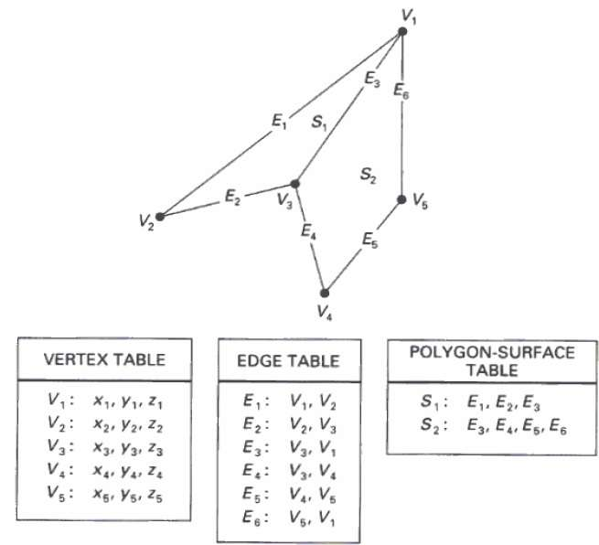
Polygon Tables
The polygon surface is specified by the set of vertex coordinates and associated attributes.
Polygon data tables can be organized into two groups: Geometric tables and attribute tables
Geometric table contain vertex coordinates , and attribute table includes the texture characteristics of object.

Slide 6
As shown in the following figure, there are five vertices, from v₁ to v₅.
Each vertex stores x, y, and z coordinate information which is represented in the table as v₁: x₁, y₁, z₁.
The Edge table is used to store the edge information of polygon. In the following figure, edge E₁ lies between vertex v₁ and v₂ which is represented in the table as E₁: v₁, v₂.
Polygon surface table stores the number of surfaces present in the polygon. From the following figure, surface S₁ is covered by edges E₁, E₂ and E₃ which can be represented in the polygon surface table as S₁: E₁, E₂, and E₃.

Slide 7
Plane Equations
The equation for plane surface can be expressed as
Ax + By + Cz + D = 0
Where (x, y, z) is any point on the plane, and the coefficients A, B, C, and D are constants describing the spatial properties of the plane.
Let us assume that three vertices of the plane are (x₁, y₁, z₁), (x₂, y₂, z₂) and (x₃, y₃, z₃).
Let us solve the following simultaneous equations for ratios A/D, B/D, and C/D. You get the values of A, B, C, and D.
(A/D) x₁ + (B/D) y₁ + (C/D) z₁ = -1
(A/D) x₂ + (B/D) y₂ + (C/D) z₂ = -1
(A/D) x₃ + (B/D) y₃ + (C/D) z₃ = -1

Slide 8
Using Cramer’s rule we can obtain the solution for the above equations in the determinant form as
1 y1 z1 1 y2 z2 1 y3 z3
x1 1 z1 x2 1 z2 x3 1 z3
A=
B=
x1 y1 1 x2 y2 1 x3 y3 1
x1 y1 z1 x2 y2 z2 x3 y3 z3
C=
D= -
Expanding the determinants, we can write the calculations for the plane coefficients in the form
A=y1(z2-z3)+y2(z3-z1)+y3(z1-z2)
B=z1(x2-x3)+z2(x3-x1)+z3(x1-x2)
C=x1(y2-y3)+x2(y3-y1)+x3(y1-y2)
D=-x1(y2z3-y3z2)-x2(y3z1-y1z3)-x3(y1z2-y2z1)

Slide 9
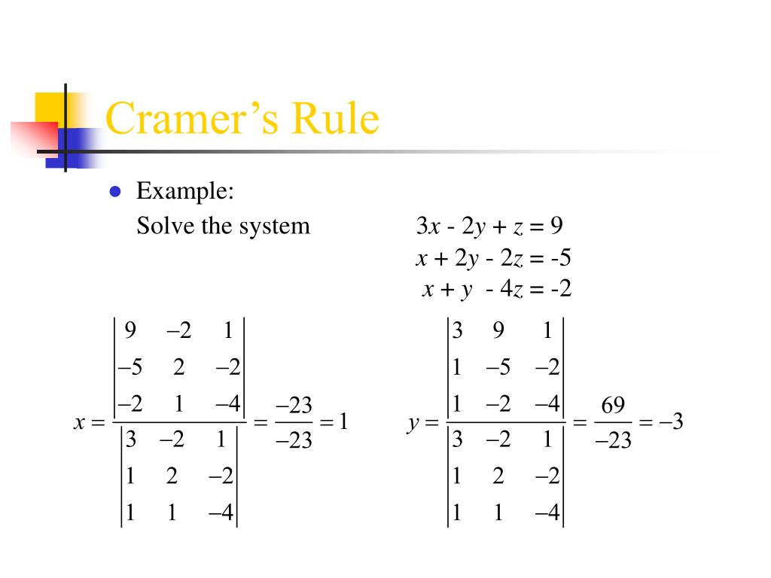

Slide 10
For any point (x, y, z) with parameters A, B, C, and D, we can say that −
Ax + By + Cz + D < 0 means the point is inside the surface.
Ax + By + Cz + D > 0 means the point is outside the surface.

Slide 11
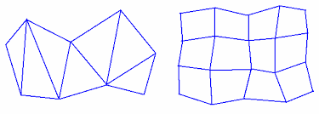
Polygon Meshes
A polygon mesh is a collection of edges, vertices and polygons are connected such that each edge is shared by at most two polygons.
One type of polygon mesh is the triangle strip, this produces n-2 connected triangles, where is the n no. of vertices.
Another type is quadrilateral mesh, which generates a mesh of (n-1)by (m-1) quadrilaterals, given the coordinates for an n by m array of vertices.(ex: 12 quadrilaterals constructed from 5 by 4 input vertex array)

Slide 12
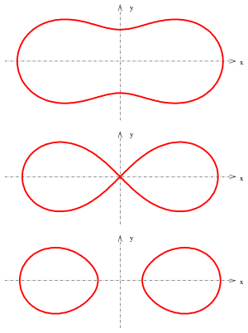
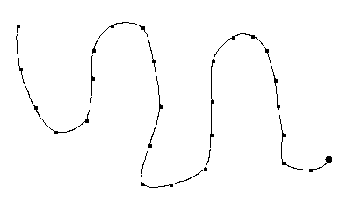
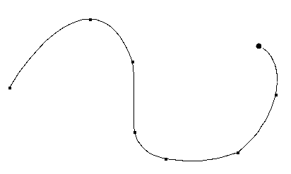
Curved lines and Surfaces
In computer graphics, we often need to draw different types of objects onto the screen.
Objects are not flat all the time and we need to draw curves many times to draw an object.
Types of Curves
A curve is an infinitely large set of points. Each point has two neighbours except endpoints. Curves can be broadly classified into three categories − explicit, implicit, and parametric curves.

Slide 13
Implicit curves:
Implicit curve representations define the set of points on a curve by employing a procedure that can test to see if a point in on the curve.
Usually, an implicit curve is defined by an implicit function of the form − f(x, y) = 0
It can represent multi-valued curves (multiple y values for an x value). A common example is the circle, whose implicit representation is
x² + y² - R² = 0
Explicit Curves:
A mathematical function y = f(x) can be plotted as a curve.
For each value of x, only a single value of y is normally computed by the function.
y=mx+c;

Slide 14
Parametric Curves
Curves having parametric form are called parametric curves. A two-dimensional parametric curve has the following form −
X=X0+(x1-x0)t
Y=y0+(y1-y0)t
the points are obtained when the parameter t is varied over a certain interval [a, b], normally [0, 1].

Slide 15

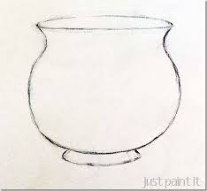
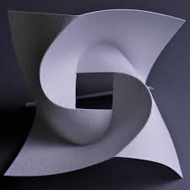
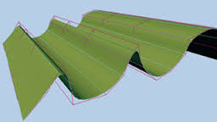
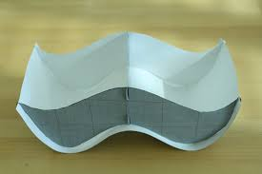

Slide 16
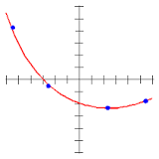
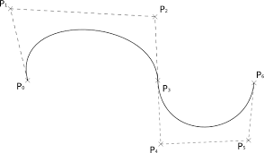
Spline Representation (parametric curves)
In computer graphics, it is a curve that connects two or more specific points.(or that is defined by two or more points.)
It’s used to produce smooth curve through designated set of points.
We can mathematically describe such a curve with a piecewise cubic polynomial function.

Slide 17
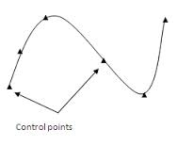
We specify a spline curve by giving set of coordinate positions, called control points, which indicates the general shape of the curve.( or a set of points that influence the curve's shape)
There are two ways to plot continuous piecewise curve
1. Interpolating spline
When the curve passes through each control points, the resulting curve is said to be interpolating spline.
Mainly used to digitize drawing or to specify animation paths.

Slide 18
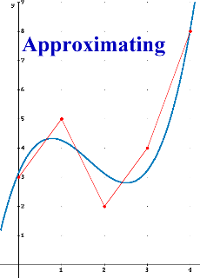
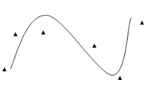
2. Approximating Spline
When the curve path without necessarily passes through any control point, the resulting curve is said to be approximating spline.
Here the control points merely influence shape.
Approximation curves are used as design tools to structure object surfaces.

Slide 19
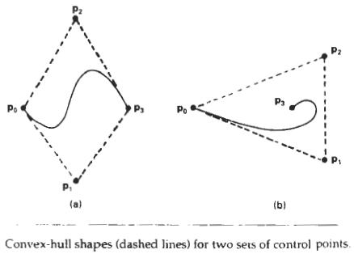
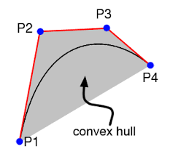
The convex polygon boundary that encloses a set of control points is called the convex hull.
The shape of the convex hull is to imagine a rubber band stretched around the positions of the control points so that each control point is either on the perimeter of the hull or inside.

Slide 20
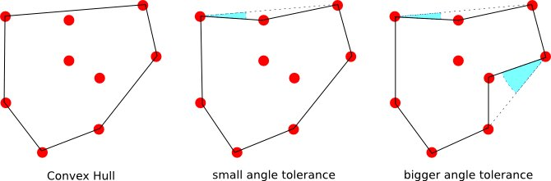

Slide 21
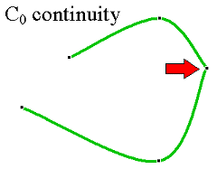
Often we will want to represent a curve as a series of curves pieced together, But we will want these curves to fit together reasonably ...
Continuity refers to how well behaved the curve is in a mathematical sense.
We set parametric continuity by matching derivatives of adjoining curve sections at their common boundary.
Zero order parametric continuity, described as C0, means simply that the curves meet.
Zero order parametric continuity
The curves meet

Slide 22
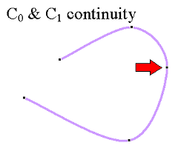
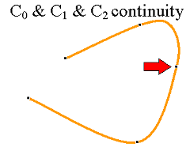
First order continuity, Where the tangents lines for two successive curves sections are equal at their joining point.
First order parametric continuity
the tangents are shared
Second order parametric continuity, means that both first and second parametric derivations of the two curves are the same at intersection.
Second order parametric continuity
The "speed" is the same before and after

Slide 23
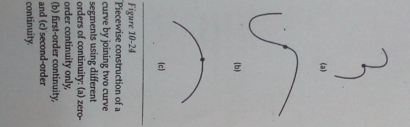

Slide 24
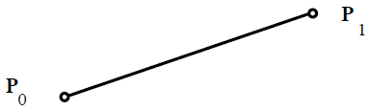
Bezier Curves and surfaces
Bezier curve is discovered by the French engineer P. Bezier. They are easy to implement, and available in various CAD systems.
These curves can be generated under the control of other points. Approximate tangents by using control points are used to generate curve.
Bezier curves are parametric polynomial curves, usually parameterized from 0 to 1.
A linear Bezier curve has the form
P(t) = (1 - t)P0 + tP1;
and represents the line segment between two points P0 and P1

Slide 25
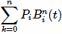
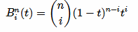
The Bezier curve can be represented mathematically as −
P(t)=
Where n is the polynomial degree, i is the index, and t is the variable.
Value of i ranges from 0 to n, where 0<=t<=1;
For 4 control points, the degree of the polynomial is 3

Slide 26
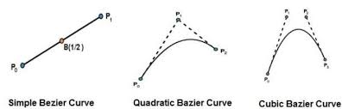
The simplest Bezier curve is the straight line from the point P0 to P1.
A quadratic Bezier curve is determined by three control points.
A cubic Bezier curve is determined by four control points.

Slide 27
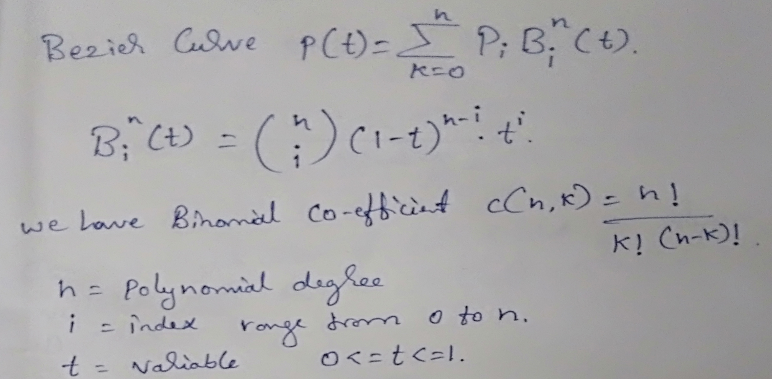
Derive the equation for Cubic Bezier curves, where 4 control points are given and degree 3. (important)

Slide 28
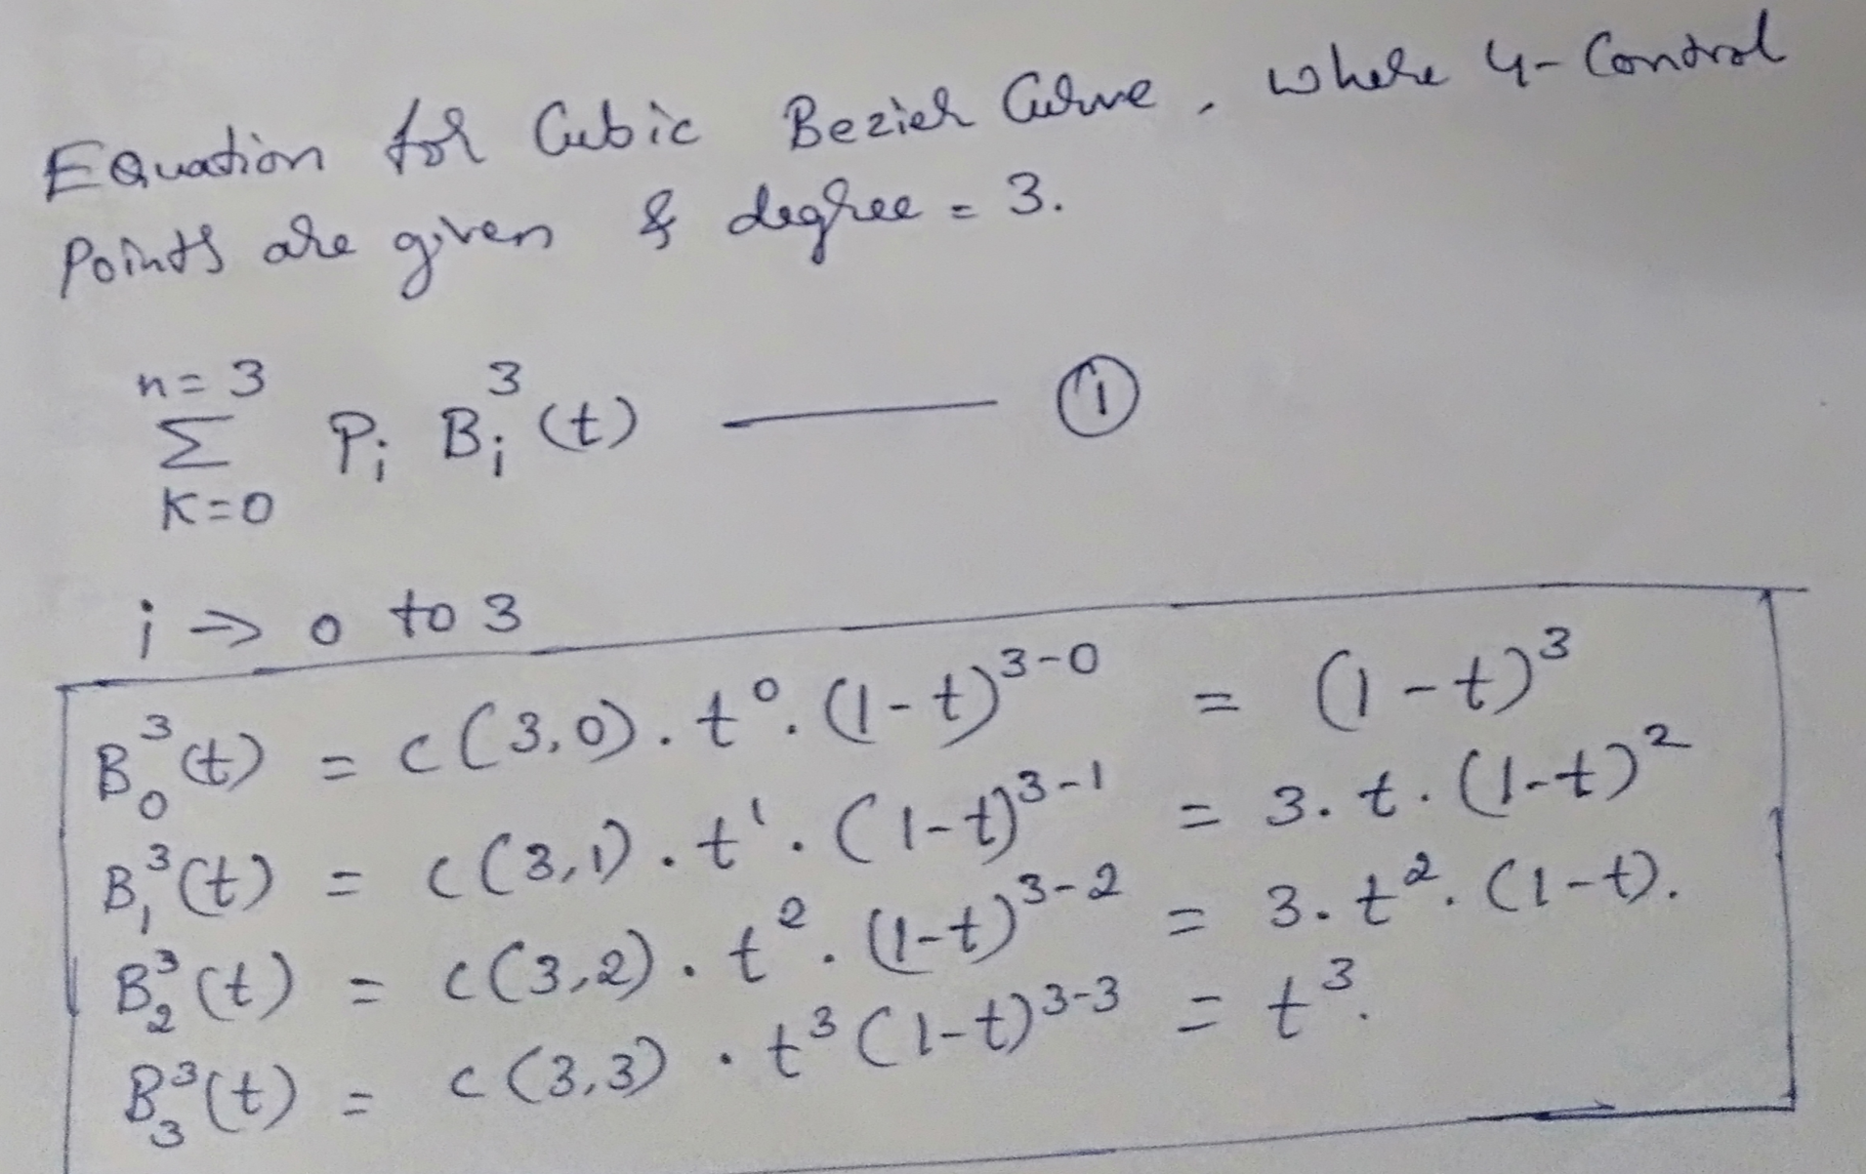

Slide 29
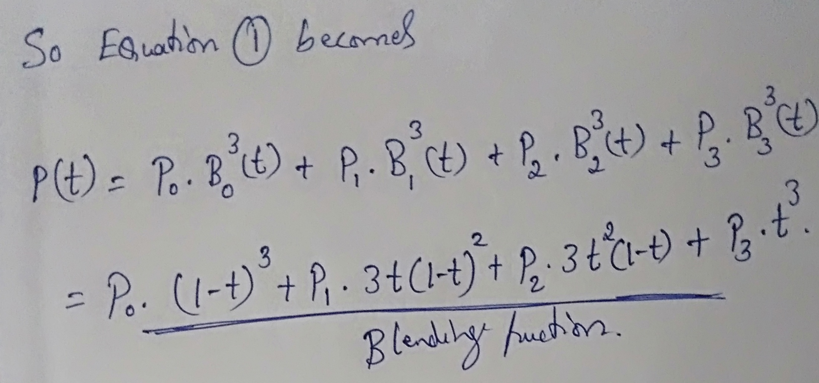

Slide 30
Construct a Bezier cure of order 3 and with 4 polygon vertices A(1,1), B(2,3), C(4,3) and D(6,4).
Bezier Curve equation:
P₀.(1-t)³+P₁.3t(1-t)²+ P₂.3t²(1-t) + P₃.t³ ---------> Eq-1
The value of t range from 0 to 1;
As there are four control points, the value of t might be(0/4,1/4,2/4,3/4)=>( 0,1/4,1/2,3/4)
Where P₀=(1,1), P₁=(2,3), P₂=(4,3), P₃=(6,4);

Slide 31
After substituting the value of to in Eq-1;
P(0)=(1,1);
P(1/4)= P₀(1-1/4) + 3.1/4.(1-1/4)² .P₁+ 3.(1/4)².(1-1/4).P₂+ (1/4)³.P₃
=(1,1)(0.42)+(0.42)(2,3)+ (0.140)(4,3) + (0.0156)(6,4)
=(0.42+0.84+0.56+0.0936) ,( 0.140+1.26+0.42+0.0624)
P(1/4)=(1.92 , 2.17)
Similarly P(1/2)= (3.125, 2.875)
P(3/4)= (4.51,3.378)

Slide 32
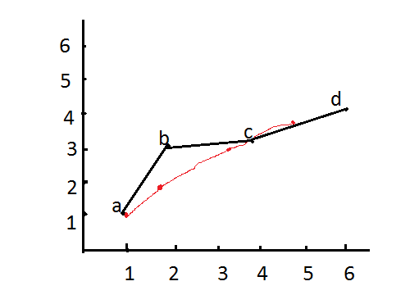

Slide 33
Properties of Bezier Curves
They always pass through the first and last control points.
They are contained in the convex hull of their defining control points.
The degree of the polynomial defining the curve segment is one less that the number of defining polygon point. Therefore, for 4 control points, the degree of the polynomial is 3, i.e. cubic polynomial.
A Bezier curve generally follows the shape of the defining polygon.
Bezier curves exhibit global control means moving a control point alters the shape of the whole curve.
A given Bezier curve can be subdivided at a point T into two Bezier segments which join together at the same point .

Slide 34
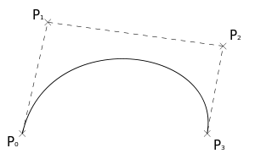
Another Approach to construct the Bezier curve is called mid point approach. In this approach the midpoints of the lines connecting control points are determined. These midpoints are connected by line segment. And repeat the same for new line segment
A cubic Bezier spline

Slide 35
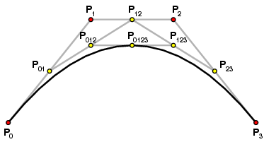

Slide 36
B-Spline Curves
The Bezier-curve produced by the Bernstein basis function has limited flexibility.
The number of specified polygon vertices fixes the order of the resulting polynomial which defines the curve.
The Bezier curves exhibit global control.
Where as,
B-spline is non-global.

Slide 37
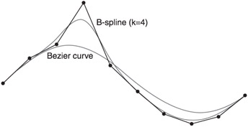
B-spline has got two advantages over Bezier
The degree of a B-spline polynomial can be set independently of the number of control points( with certain limitations)
B-spline allow local control over the shape of a spline curve or surface.

Slide 38
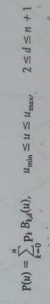
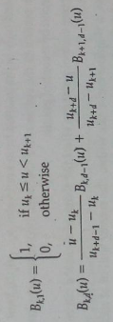
B-Spline Curves
General expression for the calculation of coordinate positions along a B-Spline curve in a blending function formulation as
Pk are the input set of n+1 control points, d= degree ( can be set independently with limitations), u= knot values it can be n+d+1 values.( segment values)
Blending function for B-Spline curves are defined by Cox-deBoor Recursive formulas:
Where each blending function is defined over d subintervals of the total range of u starting at knot value uk

Slide 39
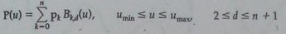
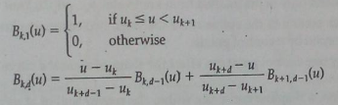
No. of blending functions is equal to the No.of control points, and
d indicates the number of segments(knots) considered for each control point.

Slide 40
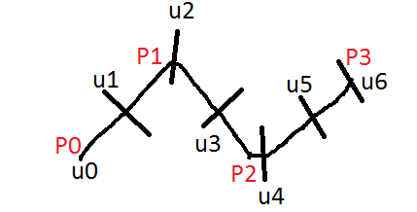
Line Segment
Lets consider a curve with 4 control points, n+1= control points, so n=3;
d range b/w 2<=d<=n+1; so d is 3;
U= number of segments/ knot number/values, it can be n+d+1;
so u=7
U={ U₀,U₁,U₂,U₃,U₄,U₅,U₆};

Slide 41
Let us assume uniform spacing between the knot values U={0,1,2,3,4,5,6};
Now in B-Spline for deciding of the curve points (Shape/slope) it consider d number of segments,
So we need to calculate blending equation at each control point.
B₀₋₃ = { 0->1, 1->2, 2->3};
B₁₋₃ ={1->2, 2->3, 3->4};
B₂₋₃ ={2->3, 3->4, 4->5};
B₃₋₃ ={3->4, 4->5, 5->6};
Line Segment

Slide 42
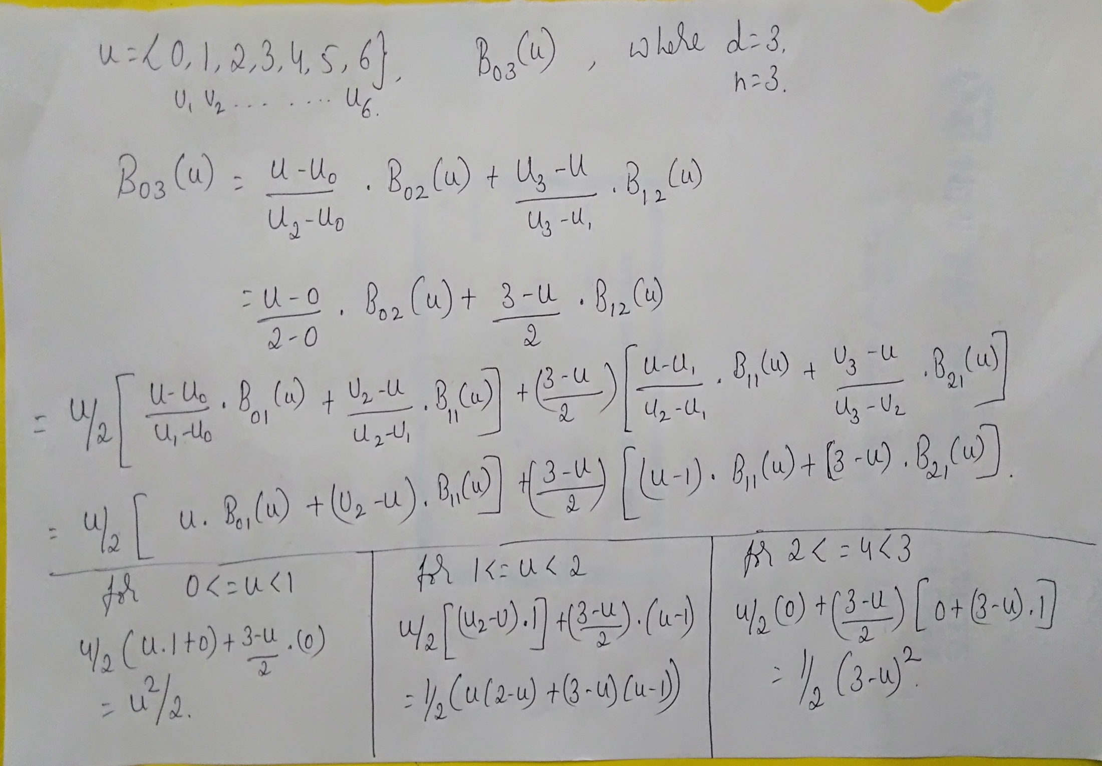

Slide 43
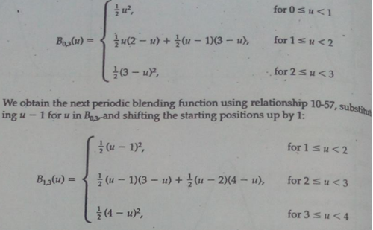
Blending function for n=3, d=3 subintervals of the range of u
Where u ={ 0,1,2,3,4,5,6} // knot values ( segments )

Slide 44
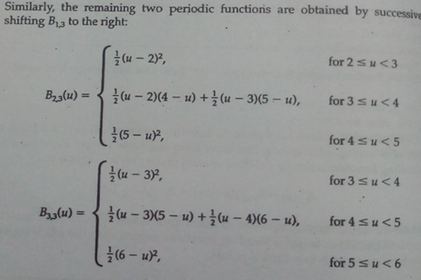

Slide 45
Properties of B-Spline curve
The degree of B-spline polynomial is independent on the number of vertices of defining polygon.
B-spline allows the local control over the curve surface because each vertex affects the shape of a curve only over a range of parameter values.
The curve can be used to define both closed and open curves
Each blending function is defined over d subintervals of the total range of u starting at knot value uk
Each section of the spline curve ( between two successive knot values) is influenced by d control points
Any one control point can affect the shape of at most d curve sections.

Slide 46
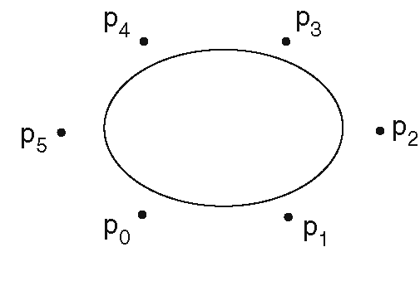
Closed, Periodic B-Spline curves

Slide 47
Classes of knot vectors
• Uniform
– Spacing between knot values is constant
Eg (0,1,2,3,4,5,6,7)
(0 0.25 0.5 0.75 1.0)
• Non-uniform
– Spacing between knot values is non-constant
Eg (01,3,4,7,8,22)

Slide 48
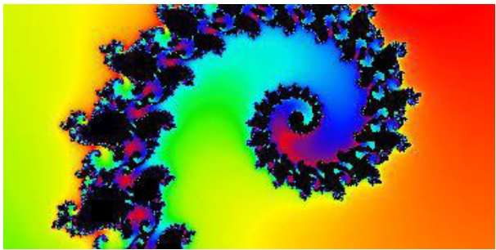
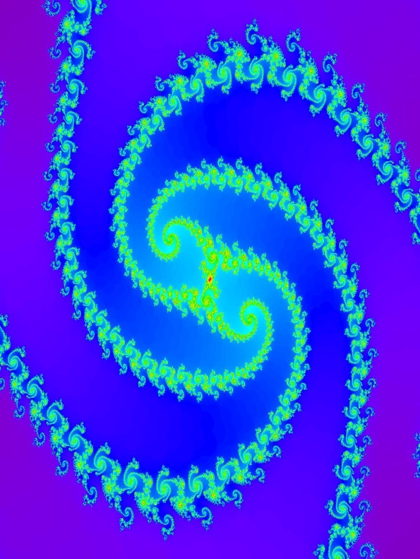
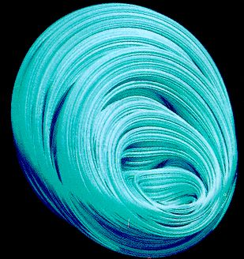
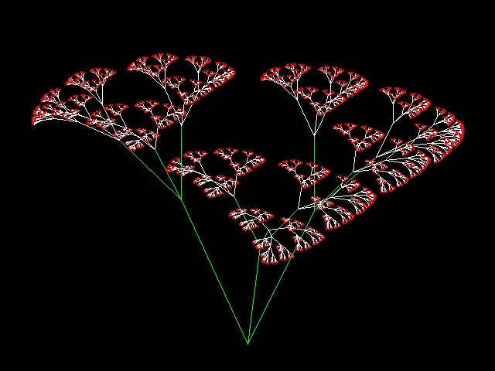
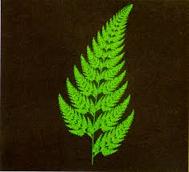
FRACTALS

Slide 49
What are Fractals?
Fractals are very complex pictures generated by a computer from a single formula.
They are created using iterations.
This means one formula is repeated with slightly different values over and over again, taking into account the results from the previous iteration.
Fractals are used in many areas in the field
Astronomy − For analyzing galaxies, rings of Saturn, etc.
Biology/Chemistry − For depicting bacteria cultures, Chemical reactions, human anatomy, molecules, plants,
Others − For depicting clouds, coastline and borderlines, data compression, diffusion, special effect, etc.

Slide 50
Fractal objects has two basic characteristics
Self Similarity between object parts and overall features of the object.
Another key characteristic of a fractal is its dimension.

Slide 51

Generation of Fractals
Fractals can be generated by repeating the same shape over and over again as shown in the following figure.
shows an equilateral triangle.
we can see that the triangle is repeated to create a star-like shape.
we can see that the star shape in figure (b) is repeated again and again to create a new shape.

Slide 52


Geometric Fractals
Geometric fractals deal with shapes found in nature that have non-integer or fractal dimensions.
we start with a given geometric shape, called the initiator. Subparts of the initiator are then replaced with a pattern, called the generator.

Slide 53



Classification of Fractals
Self-Similar fractals have parts that are scaled down versions of the entire objects. We construct the object subparts by applying a scaling parameter s to the overall shape.
If we apply random variations to the scaled-down subparts, the fractal is said to be Statistically self-similar.
Self-statistically self-similar
Self Similar fractals

Slide 54


Self-affine fractals have parts that are with different scaling parameters Sx,Sy,Sz in different coordinate directions.
Then random variations helps to obtain statistically self affine fractals. Ex: Terrain, Water, Clouds.
Invarient Fractal sets are formed with non-linear transformations. This class of fractals include self-squaring fractals, such as the mandelbrot set.
Self-affine fractal
Invariant fractal set

Slide 55
Illumination and shading
Here we learn how to shade surfaces based on the position, orientation and characteristics of the surfaces and the light illuminating them.
We have different illumination models that express the factors determining a surface’s color at a given point.
Illumination model also called as lighting model or shading models.
The shading model is the one which basically determines when illumination model is applied and what arguments it will receive.
Ex: some shading model invoke an illumination model for every pixel in the image, where others invoke only some pixels, and shade the remaining pixels.

Slide 56


Illumination models
It’s a mathematical model that determines the interaction of light with objects.
1.Ambient light
It usually refers to natural light, either outdoors or coming through windows etc. It can also mean artificial lights such as normal room lights.
It can be expressed as I=IaKa
Ia is the intensity of the ambient light, ka is the amount of ambient light reflected from an objects surface. I represent the resulting intensity.
Ka, The ambient reflection coefficient ranges from 0 to 1 .(It’s a material property)

Slide 57



Slide 58

2.Diffuse reflection
It is the reflection of light from a surface, such that an incident ray is reflected at many angles rather than at just one angle as in the case of specular reflection.
Now consider illuminating an object by a point light source.
2a. Lambertian reflection: Dull, matte surfaces. These surfaces appears equally bright from all viewing angles because reflect light with equal intensity in all directions.
According to this intensity(brightness) depends on the angle between the N and L to the light surface.
I=Ip Kd cosθ
Ip intensity of point light,
Kd is the diffussed light coefficient (0 to 1) based on material.
Θ angle of distance.
Illumination can be more improved by adding a ambient light
I=IaKa+Ip Kd cosθ
_
_
I=IpKd ( N .L)

Slide 59
2b.Light source attenuation:
This illumination model overcomes the disadvantage of Lambertian reflection which defines variation in the intensity of the surface with respect to distance of object and the light source.
To calculate this intensity, it multiplies a factor called light source attenuation factor (fatt) to the existing illumination model.
Intensity is given by
I=Iaka+fatt*Ip*Kd(Cosθ)
fatt=1/ D²_{L}
Where DL is distance from light source to the object

Slide 60
2c. Colored light and surfaces:
This illumination model is used to determine the intensity of the colored surface object and colored light is used for illumination.
In this case the intensity of the surface depends on three components R G B intensity value of the object surface.
I=IR + IG + IB
IR=IaR Ka OdR + fatt IpR kd OdR
Where IaR is red intensity of ambient light
OdR object diffuse value for red
IPR,IPG,IPB are reflected in proportion to KdOdR,KdOdG,KdOdB respectively.
Similar equations are used for green and blue components
_
_
(N.L)

Slide 61
3.Atmospheric Attenuation:
The loss of brightness of a beam of light due to the atmosphere
This illumination model describes the variation in the intensity recurring due to atmospheric attenuation caused by the distance between object and viewer.
This is done by using depth-cueing approach.
Where more distant objects are rendered with lower intensity than are closer ones.
It uses a scaling factor varies b/w 0 and 1;
I’λ = S0Iλ + (1-S0)Idcλ
Where Idcλ is depth cue color
Iλ is previously computed intensity, S0 varies from 0 to 1
Λ is wavelength dependent on R G B.

Slide 62

4. Specular Reflection
It can be observed on any shiny surface.
Illuminate an apple with a bright white light: The highlight is caused by specular reflection, whereas the light reflected from the rest of the apple is the result of diffuse reflection. Note that highlight appears not to be red, but white(color of incident light). Move your head, highlight also moves.
So non shiny surface reflect light unequally in different direction.
Where as on perfectly shiny surfaces such as mirror, light is reflected only in the direction of reflection R .

Slide 63
The Phong illumination model:
Illumination model for non perfect reflectors, such as apple.
It assumes that maximum specular reflectance
occurs when α is zero and falls off sharply as
α increases.
The specular reflection changes with respect
to the viewer angle( change in the intensity factor)
So the model to calculate the intensity uses four factors
L,N,R,V;
cos θ= N.L and cos α =R.V;
n varies from 1 to several 100.
Ks is material specular reflection, a constant value selected experimentally
First model to account for viewers and lights at arbitrary positions.
Iλ = IaλKa Odλ+ fattIpλ[ kd Odλ(N.L) +ks(R. V)^n]

Slide 64
Shading Models for polygons
It should be clear that we can shade any surface by calculating the surface normal at each visible point and applying the desired illumination model at that point. But this brute force technique is expensive.
Constant Shading: The simplest shading model for a polygon, also known as flat shading.
This approach applies an illumination model once to determine the single intensity value, that is then used to shade an entire polygon.
Here we are sampling the value of the illumination equation once for each polygon and holding the value across to shade polygon.

Slide 65

Interpolated shading:
(interpolation is a method of constructing new data points within the range of a discrete set of known data points.)
Its an alternative to evaluating the illumination equation at each point on the polygon.
In this approach shading information is linearly interpolated across a triangle from the values determined for its vertices.
Polygon mesh shading:
Suppose if the curved object is constructed by polygon mesh. In this approach each polygon face in the mesh is shaded individually. Then it is easily distinguished from neighbors, whose orientation is different.
At the border between two faces,
the dark looks darker and
light face looks lighter.
(Intensity discontinuous)

Slide 66

vertex normal vector is to calculate the angle between the light source and the surface.
As angle varies then intensity of the pixel also varies.

Slide 67

Gouraud shading:
Its also called as intensity interpolation shading, which eliminates intensity discontinuities.
It extends the concept of interpolated shading applied to individual polygon by interpolating polygon vertex illumination value.
And it also requires the normal( angle b/w light and normal vector) be known for each vertex of the polygon mesh.
If an edge is meant to be visible(as at the joint b/w plane wing and body), we find two vertex normal's and intensity is identified.
In this approach vertex intensities
is find by using the vertex normal’s
with any desired illumination model.
Finally each polygon is shaded by linear interpolation
of vertex intensities along each edge and then b/w scan lines

Slide 68

Phong shading:
It interpolates surface normal's across rasterized polygons and computes pixel colors based on the interpolated normal's and a reflection model.
Interpolation along edges is done by means of incremental calculations.
( Here illumination model is applied on
different points of the edge to identify
the intensity of the selected pixel,
same approach is applied for each
Scan line);
OR
This shading achieves better approximation to the true shape of a surface and thus better rendering of the surface by determining surface normals at each point using linear interpolating techniques. This process is computationally expensive.

Slide 69


Slide 70


Problems with Interpolated Shading
silhouette( show as a dark edge)
1.Polygon Silhouette: No matter how good an approximation an interpolated shading model offers to the actual shading of the curved surfaces, but still the silhouette edge of a mesh is still clearly polygonal.
2.Perspective distortion: anomalies are introduced because interpolation is performed after the perspective transformation in the 3D screen-coordinate system rather than in WC system.

Slide 71

3.Orientation dependence: Interpolated shading model is not dependent of the polygon orientation. So intensity of the object varies if its rotated, so representation is deviate from the expected result.

Slide 72

4.Problems at shared edge:
Shading discontinuities can occur when two adjacent polygon fail to share a vertex lies along their common edge.
Ex: B is shared by two polygons on the right, but not by the large polygon on the left. The shading information determined at point B for the polygon at the right will not be same as the information interpolated at that point from the values of A and C for the polygon at the left. As a result, there will be a discontinuity in the shading.

Slide 73

5.Unrepresentative vertex normals:
Computed vertex normals may not adequately represent the surface’s geometry.
Ex: if we compute vertex normals by averaging the normals of the surfaces sharing a vertex, all of the vertex normals will be parallel to one another, resulting in little or no in variation in shade if the light source is distant.

Slide 74
Shadow
A shadow is a space where light from a light source is blocked by an opaque object.
Visible surface algorithms to determine which surfaces can be seen from the viewer.
Shadow algorithms determine which surfaces are visible to light source.
The surfaces that are visible from the light source are not in shadow, those that are not visible from the light source are in shadow.

Slide 75
A two pass object-precision shadow algorithm
Here weiler-Atheron Algorithm is applied twice on the description of object, once for the Viewpoint, and once for the light source.
The result are then combined to determine the pieces of each visible part of a polygon and the scene is scan converted.

Slide 76
Steps in algorithm:
First it determines those surfaces that are visible from the light source’s viewpoint, using Weiler-Atheron Visible –surface algo.
The o/p of this pass is a list of lit polygons, each of which is tagged with the identity of its parent polygon.
Now lit polygons are transformed back into the modeling coordinates and are merged with a copy of the original database as surface detail polygons creating a viewpoint independent merged database.( transformation is performed on both database before merging them);
Visible surface determination is applied on the merged database from the viewpoint of an arbitrary observer, again using Weiler_Atheron Algo.
The result is then given to polygon scan-conversion algorithm to render the image.

Slide 77

Refer page No-772 for complete diagram

Slide 78

Lit surface-detail polygon (Viewport independent merged database)

Slide 79

Shadow volumes
Crow describes how to generate shadow volumes for each object from the light source.
A shadow volume is defined by the light source and an object and is bounded by a set of invisible shadow polygons.
There is a quadrilateral shadow polygon, Note the shadow volumes is generated to only for polygons facing the light.
The main technique is shadow polygons are completed on one end by the original object polygon and on the other end by a scaled copy of the object polygon, whose normals are inverted.
This scaled copy is located at a distance from the light at a assumed distance and is negligible.

Slide 80


A front facing shadow polygon polygon A and B
Causes those object behind it to be shadowed.
Shadow polygons are not rendered themselves, but are used to determine whether the other objects are in shadow. Relative to the observer.
Consider a vector from a view point V to a point on an object. The point is in shadow if the vector intersects more front-facing than back-facing shadow polygons. This point A and C are in shadow and B is visible
Fig: Determining whether a point is in shadow for a viewer at V. Dashed lines define shadow volumes(shaded in gray) (a) V is not in shadow. Point A and C are shadowed; point B is lit. (b) V is in shadow. Points A, B and C are shadowed.

Slide 85
QUADRIC SURFACES
A frequently used class of objects are quadric surfaces, which are described with second-degree equations. They include Spheres, Ellipsoids, Torus.
They are often available in graphic packages as a primitives from which complex objects can be constructed.

Slide 86



Sphere In Cartesian coordinates, a spherical surface with radius r centered on the coordinate origin is defined as the set of points (x, y, z) that satisfy the equation
We can also describe the spherical surface in parametric form, using latitude and longitude angles

Slide 87




Ellipsoid An ellipsoidal surface can be described as an extension of a spherical surface where the radii in three mutually perpendicular directions can have different values

Slide 88



Torus
A torus is a doughnut shaped object.
Let the radius from the center of the hole to the center of the torus tube be r , and the radius of the tube be rx,ry,rz .
The Cartesian representation for points over the surface of a torus can be written in the form.
and the parametric equations are

Slide 89


